Slide 1
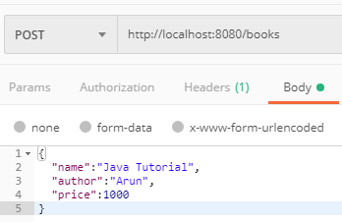

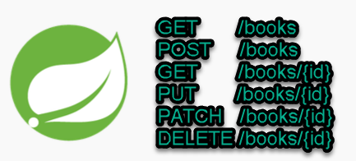
Spring boot - REST Validation Example - Custom Validator
Postman client
SpringBootDemo
DB
Consuming a RESTful Web Services by using Postman client
REST Endpoints to Create/Update/
Get/Delete book details

Slide 2
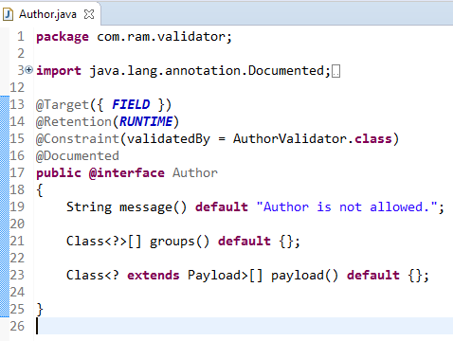
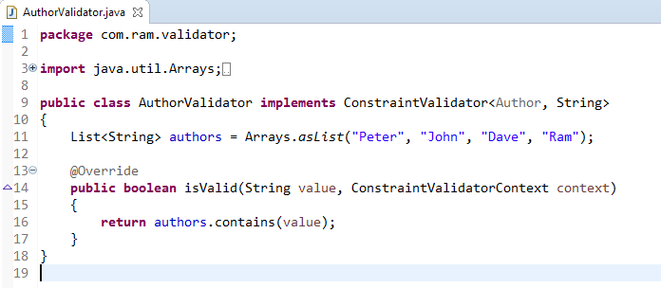
Spring boot - REST Validation Example - Custom Validator
1
We will create a custom validator for the author field, only allowing 4 authors to save into the database.
2

Slide 3
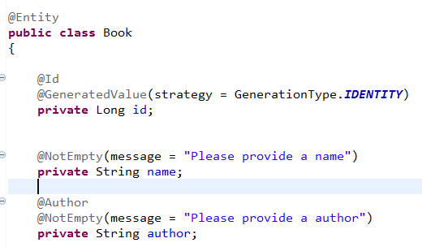
Spring boot - REST Validation Example - Custom Validator
If the custom validator is failed, it will trigger a MethodArgumentNotValidException
3

Slide 4
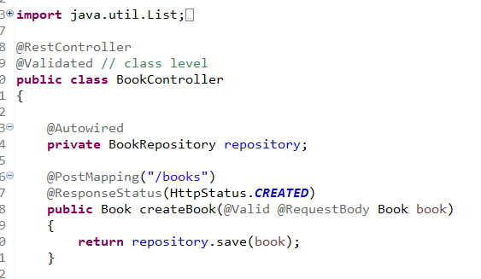
Spring boot - REST Validation Example - Custom Validator
4
Apply @Validated on class level, and add the javax.validation.constraints.* annotations on path variables

Slide 5
Default Validation
1. First add belo dependency in pom.xml file
<!-- https://mvnrepository.com/artifact/org.springframework.boot/spring-boot-starter-validation -->
<dependency>
<groupId>org.springframework.boot</groupId>
<artifactId>spring-boot-starter-validation</artifactId>
<version>2.3.3.RELEASE</version>
</dependency>
2. @Valid @RequestBody Product product // add @Valid on request body entity class
3. Add appropriate annotation on model class like @NotNull, @Size(Max=100)

Slide 6
Custome Validtion:
1. Create a annotation class
2. Creation validator class
3. Add that annotation class annotation to Class or field or method
Model Class
@PriceValid(message="invlid price")
private int price;
Annotation class
@Constraint(validatedBy=PriceValidation.class)
@Target({ElementType.TYPE,ElementType.FIELD})
@Retention(RetentionPolicy.RUNTIME)
@Documented
public @interface PriceValid {
String message() default "Price can not be less than 10";
Class<?>[] groups() default {};
Class<? extends Payload>[] payload() default {};

Slide 7
public class PriceValidation implements ConstraintValidator<PriceValid, Integer> {
@Override
public boolean isValid(Integer price, ConstraintValidatorContext arg1) {
//arg1.disableDefaultConstraintViolation();
if(price > 10)
{
return true;
}
else
{
//arg1.buildConstraintViolationWithTemplate("Price is Less than10").addConstraintViolation();
return false;
}
}

Slide 8
ExceptionHandler to return clean and clear error message.
Create a Exception Handler class by extending ResponseEntityExceptionHandler class.
Add all exception handler method which are expected from controller, service class.
@RestControllerAdvice
public class CustomExceptionHandler extends ResponseEntityExceptionHandler {
private static final Logger LOG = LoggerFactory.getLogger(CustomExceptionHandler.class);
@Override
protected ResponseEntity<Object> handleMethodArgumentNotValid(MethodArgumentNotValidException ex,
HttpHeaders headers, HttpStatus status, WebRequest request) {
String errorMessage= ex.getBindingResult().getAllErrors().stream().
map(ObjectError::getDefaultMessage).collect(Collectors.joining(","));
ErrorResponse error = new ErrorResponse(HttpStatus.BAD_REQUEST, errorMessage);
//return super.handleMethodArgumentNotValid(ex, headers, status, request);
return handleExceptionInternal(ex, error, headers, status, request);
}
@ExceptionHandler(value=Exception.class)
@ResponseBody
public ResponseEntity<ErrorResponse> handleApiException(Exception ex)
{
ErrorResponse error = new ErrorResponse(HttpStatus.INTERNAL_SERVER_ERROR, ex.getMessage());
return new ResponseEntity<ErrorResponse>(error, error.getStatus());
}

